Slide 1
Presentation College (San F’do) Library
EBSCOHost
and the
Presentation College Student

Slide 2
Ebscohost: an introduction
The library subscribes to many online databases through Ebscohost.
These databases are really helpful for completing homework assignments, project, SBA and IA.

Slide 3
Ebscohost: what is it?
EBSCOhost is a powerful and costly internet-based research system provided for students, academic instructors and researchers who require reliable, authoritative and scholarly information.
The EBSCOhost databases cater to a variety of subject needs. These include:
Science: Science Reference
Business: Business Source Premier
Literature: Literary Reference Center
Communication Studies: Points of View
Social Studies/Caribbean Studies: The Caribbean Search

Slide 4
Are scholarly databases better than websites?
Yes, yes and Yes Again.
Example: You are asked to research the level of internet addition amongst teens.

Slide 5
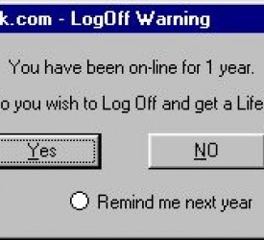
Notes:
You can Google it, check Wikipedia, a blog or a Facebook page. The information may be correct. But what you need to ask yourself whenever you are doing serious research is “Is the information Valid”, and “And is the author an authority in the field.

Slide 6
Serious research requires use of Scholarly Databases
The information in scholarly databases tends to be more credible.
All information are reviewed by experts before inclusion in the database.
Thus, you are guaranteed high-quality materials.
Notes:
Serious research should be restricted to valid and authoritative sources.

Slide 7
How to use Ebscohost databases

Slide 8
Basic Search
When you first login to an EBSCO database you will see the Basic Search box.
Type your search into the box and click the Search button.

Slide 9
Basic search: Exact searching
For exact searching put quotation marks around the search terms (e.g.; “Internet addiction" or “Organic chemistry").

Slide 10
Basic search: Using AND / OR
Use AND between two (or more) keywords or phrases to search for articles containing both terms.
e.g.; Internet AND addiction; Internet AND addiction AND teenager; “Internet addiction” AND teenager; .
Use OR between keywords to search for articles containing either term
e.g.; Internet addiction AND (teenager OR adolescent).
Notes:
With Boolean logic you can combine AND and OR. AND is the default.

Slide 11
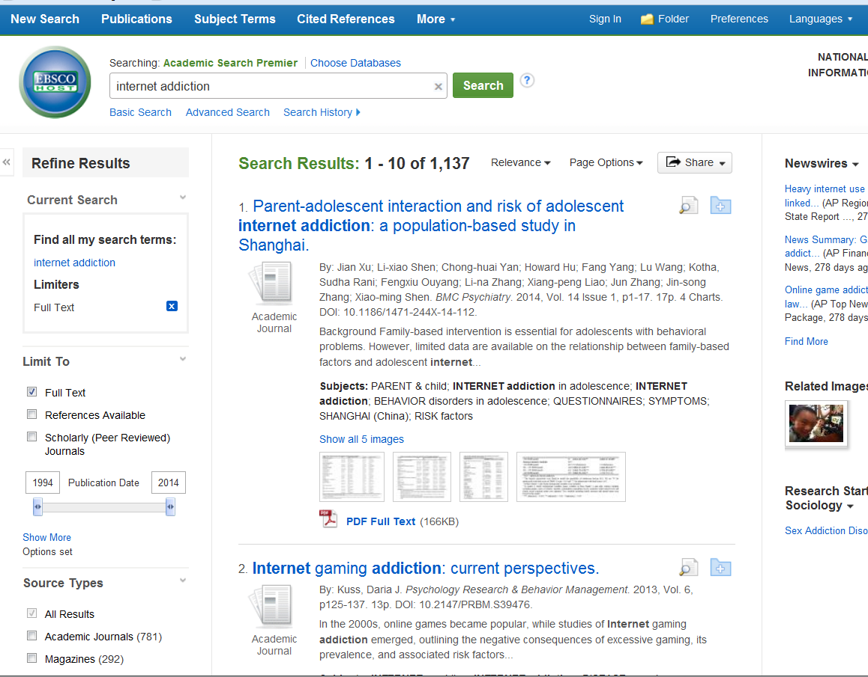
Results List: numbers of docs retrieved
The total number of document s retrieved are displayed at the top.
By default 10 search results per page are displayed.

Slide 12
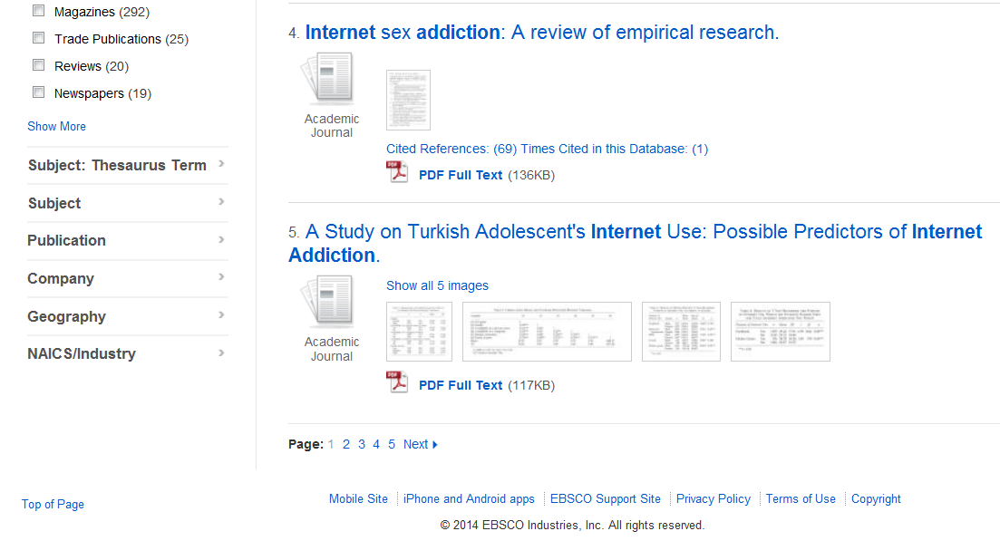
Results List: pages
If there is more than one page of search results, you will see additional page numbers at the bottom.
Notes:
If there is more than one page of search results, you will see page numbers at the top and bottom so you can look at all of them.

Slide 13
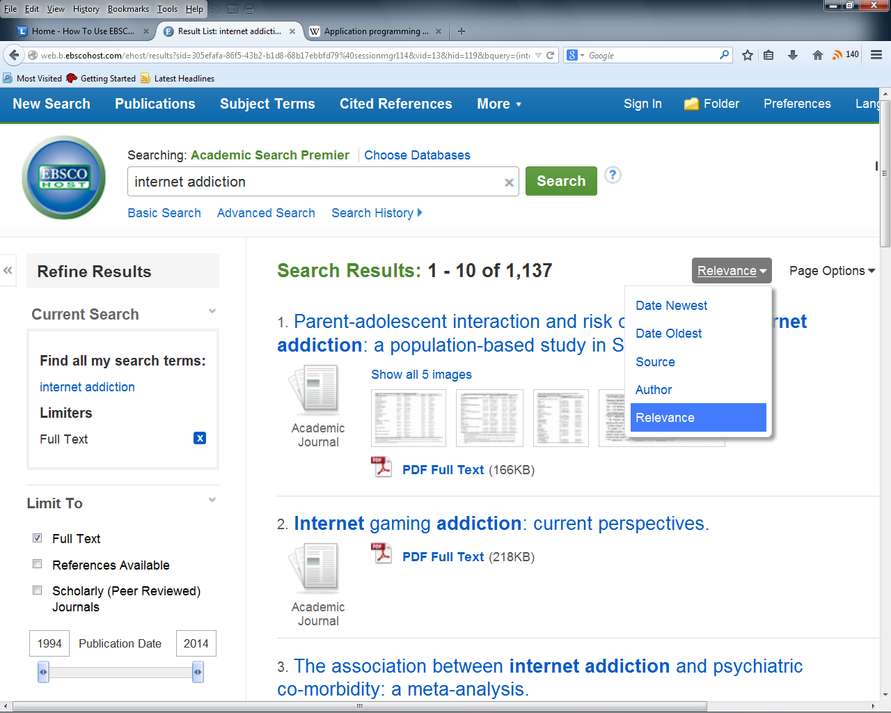
Results List: sorting
By default, search results are sorted by Relevance.
Pull down the menu and you may also sort the results by newest, oldest, source and author.

Slide 14
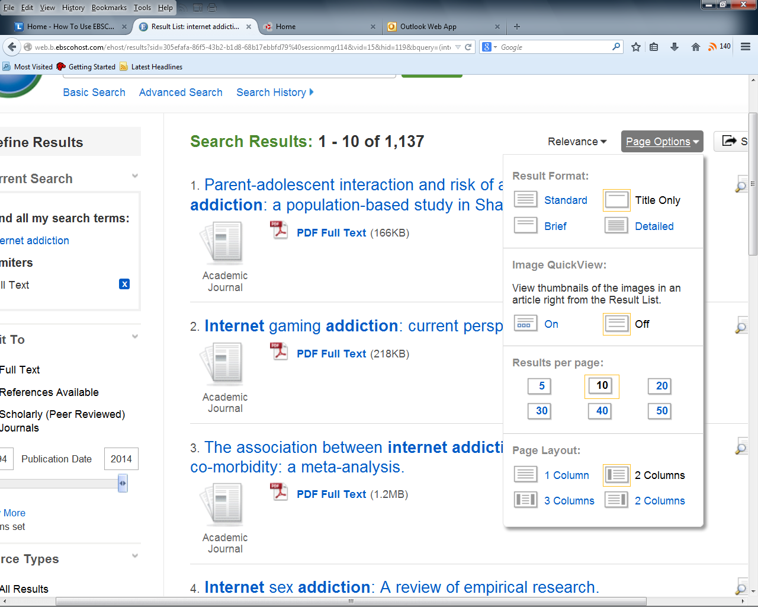
Results List
Page Options menu allows changes to
the layout of results on the page,
images visibility,
number of results shown per page and
the format of the result.

Slide 15
Results List
To the left of each search result you'll see an icon telling you what kind of document it is –
article from an academic journal,
article from a magazine, conference proceedings, case study, etc.
Beneath each search result is information on how to get the full-text of the article .

Slide 16
Results List: filters
On the left side of the search results page is a column of options to filter your search results:
Filter by full-text.
Filter by a publication date range.
Filter by scholarly (peer reviewed)
The title of the article is a link to the Article Information page.
Notes:
On the left side of the search results page is a blue column of options to filter your search results:
Filter by a publication date range.
Filter by scholarly (peer reviewed) (gets rid of magazine and newspaper articles, conference proceedings, etc.)
Filter by full-text (gets rid of search results that aren't in full-text in this database).

Slide 17
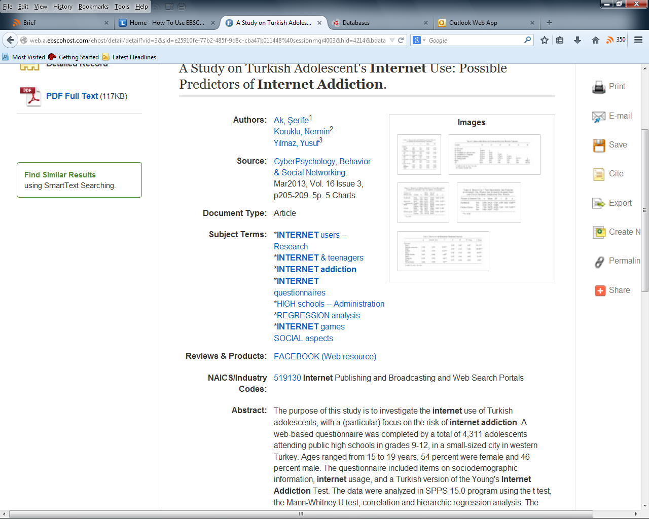
Article information
On the Article Information page, you will find:
Authors,
Source i.e. journal name, vol, date etc.
Subject terms and keywords
Abstract etc.
Notes:
Abstract, which is a summary of the article's content. Read this before you spend too much time trying to locate or read the full-text!

Slide 18
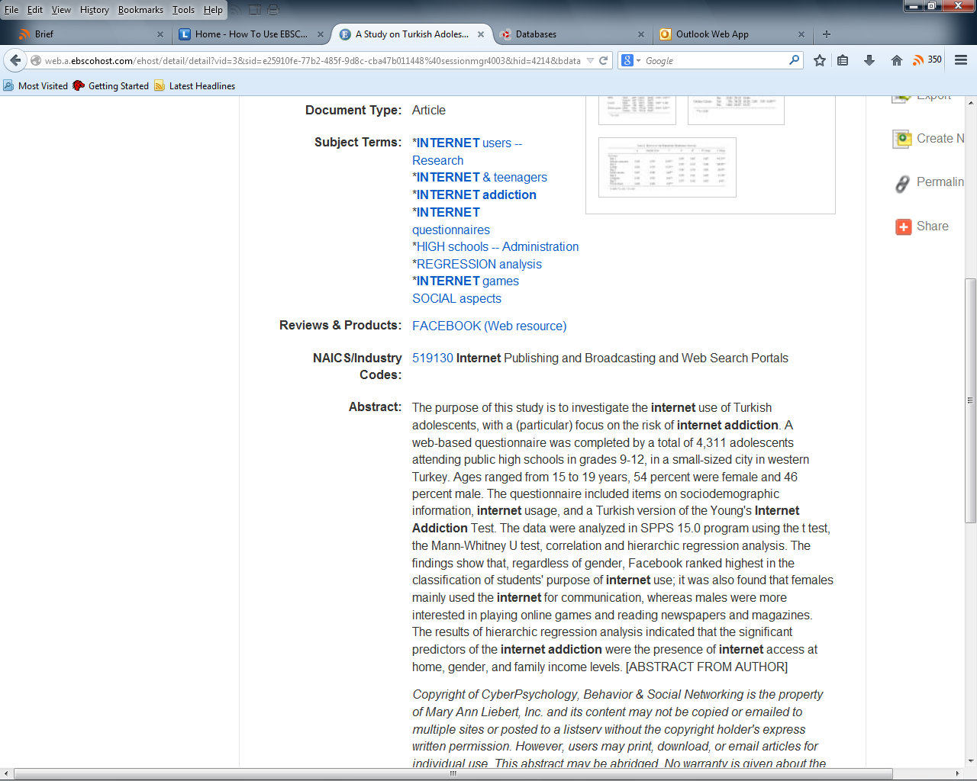
Article info.: Abstract
Abstract is a summary of the article's content. Read this before you spend too much time trying to locate or read the full-text!
Notes:
Abstract, which is a summary of the article's content. Read this before you spend too much time trying to locate or read the full-text!

Slide 19
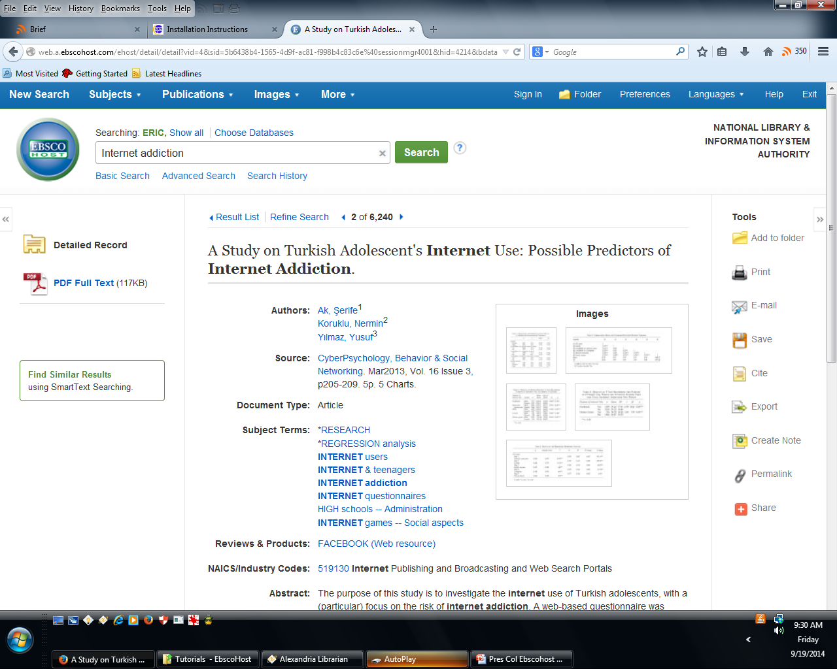
Results List: Article information
Print
Save
and
Email facilities enable you to create a copy of the article without having to search for it in the database again.

Slide 20
Results List: Citing
Citing the article in multiple citation styles.
Notes:
How to cite the article in multiple citation styles.

Slide 21
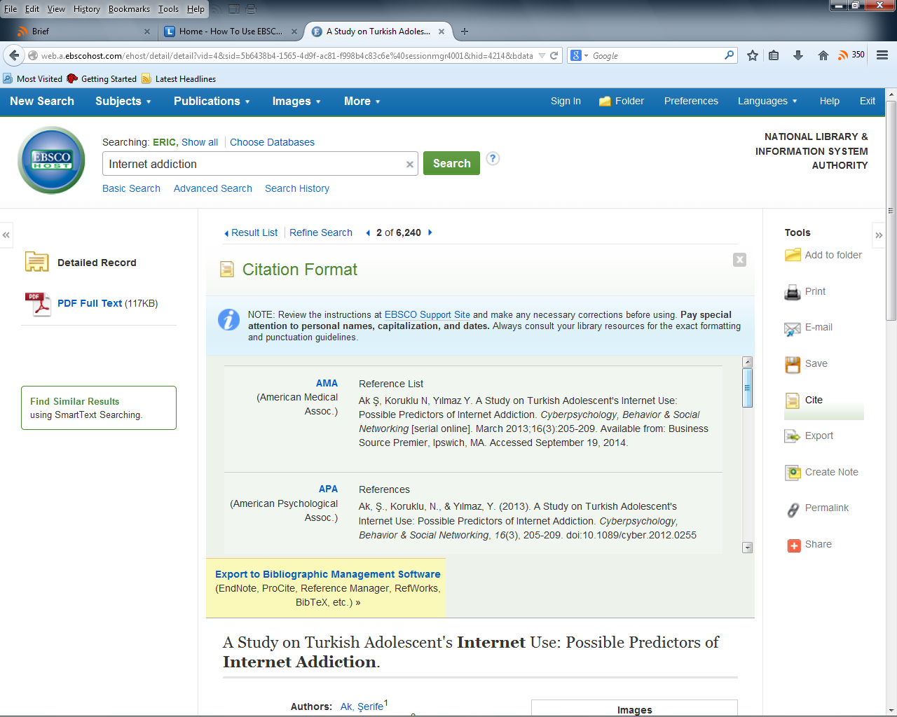
Article info.: Citing
Citation Standards include:
AMA (American Medical Assoc)
APA (American Psychological Assoc)
Chicago/Turabian
Harvard
MLA(Modern Language Assoc.)
Vancouver/ICMJE
Notes:
AMA (American Medical Assoc)
APA (American Psychological Assoc)
Chicago/Turabian
Harvard
MLA(Modern Language Assoc.)
Vancouver/ICMJE

Slide 22
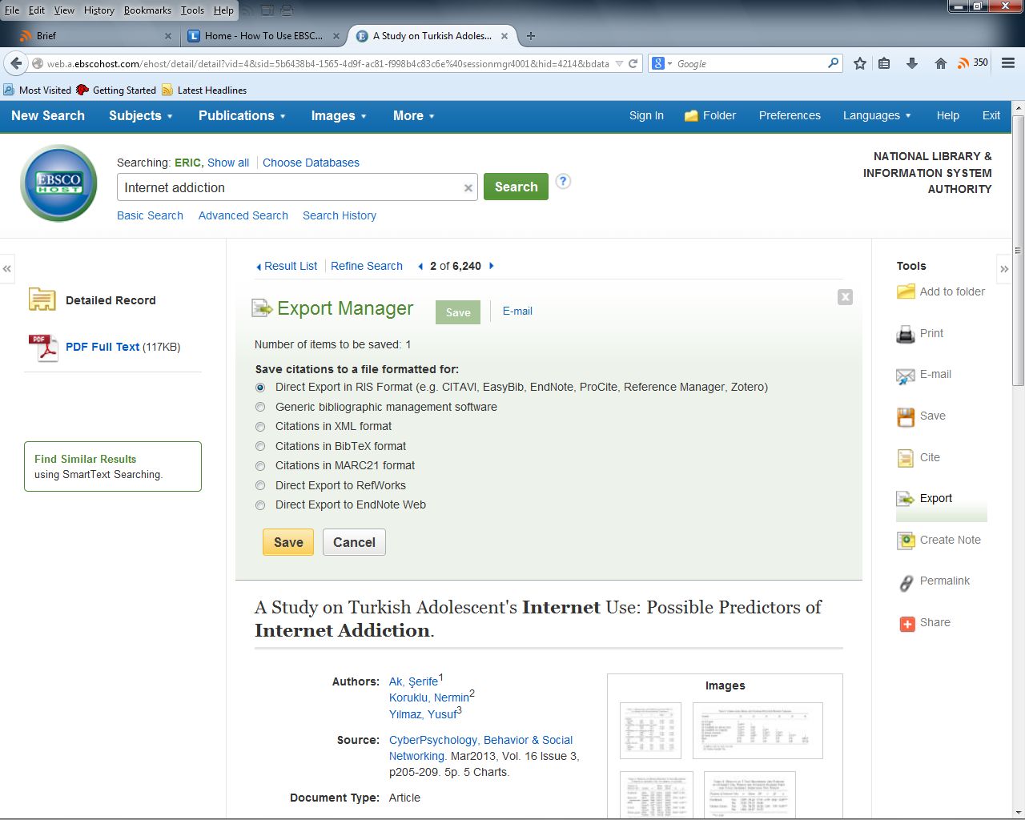
Article info.: Exporting citation
Citation Standards include:
AMA (American Medical Assoc)
APA (American Psychological Assoc)
Chicago/Turabian
Harvard
MLA(Modern Language Assoc.)
Vancouver/ICMJE
Notes:
AMA (American Medical Assoc)
APA (American Psychological Assoc)
Chicago/Turabian
Harvard
MLA(Modern Language Assoc.)
Vancouver/ICMJE

Slide 23
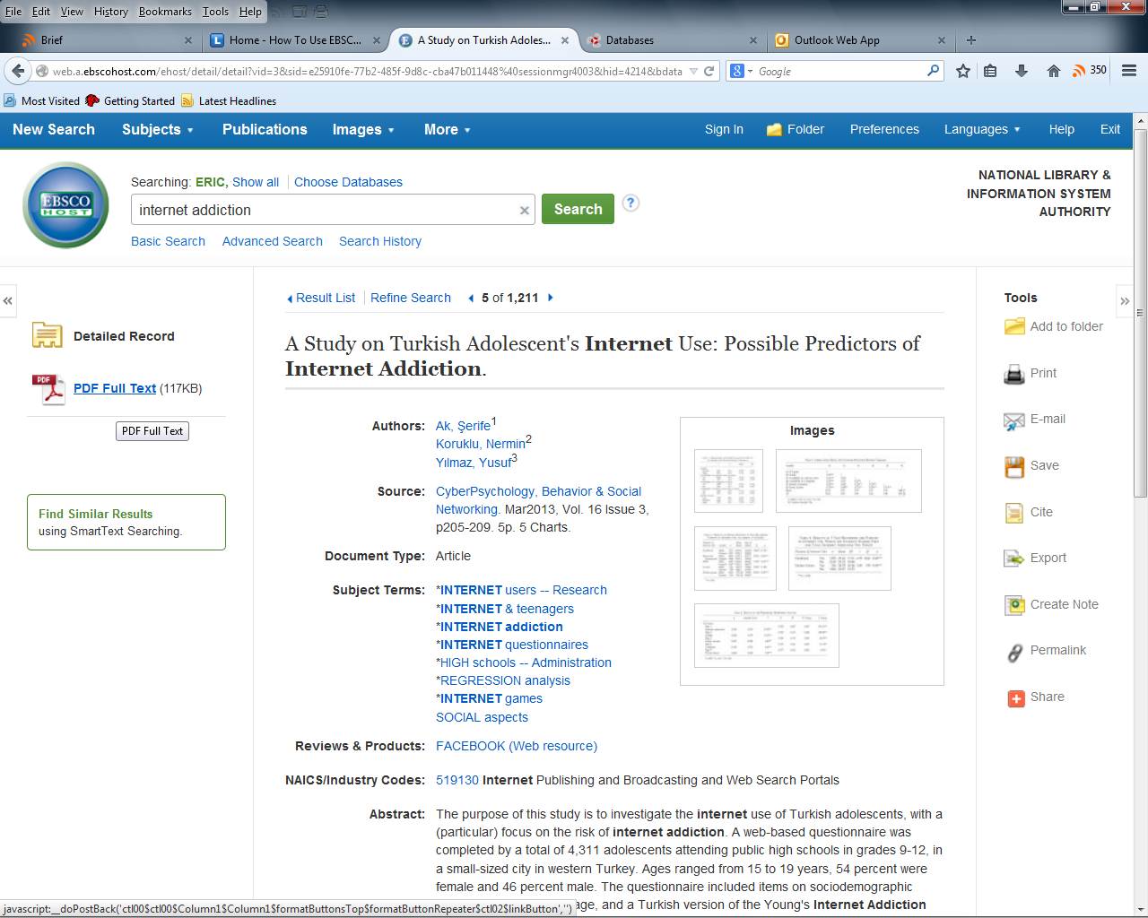
Full text of document
On the search results page, you will see the full-text link right below each search result.
On the article information page, you will see the full-text link at the top left corner of the page.
Clicking on PDF Full Text link will open the document so you read it.
Notes:
On the search results page, you will see the full-text link right below each search result.
On the article information page, you will see the full-text link at the top left corner of the page.
PDF full-text or HTML full-text
When the article is available in the database, you will see a little icon for it.
PDF full-text has the exact same appearance as the print version.
HTML full-text has the same words and images, but the layout is like a web-page.

Slide 24
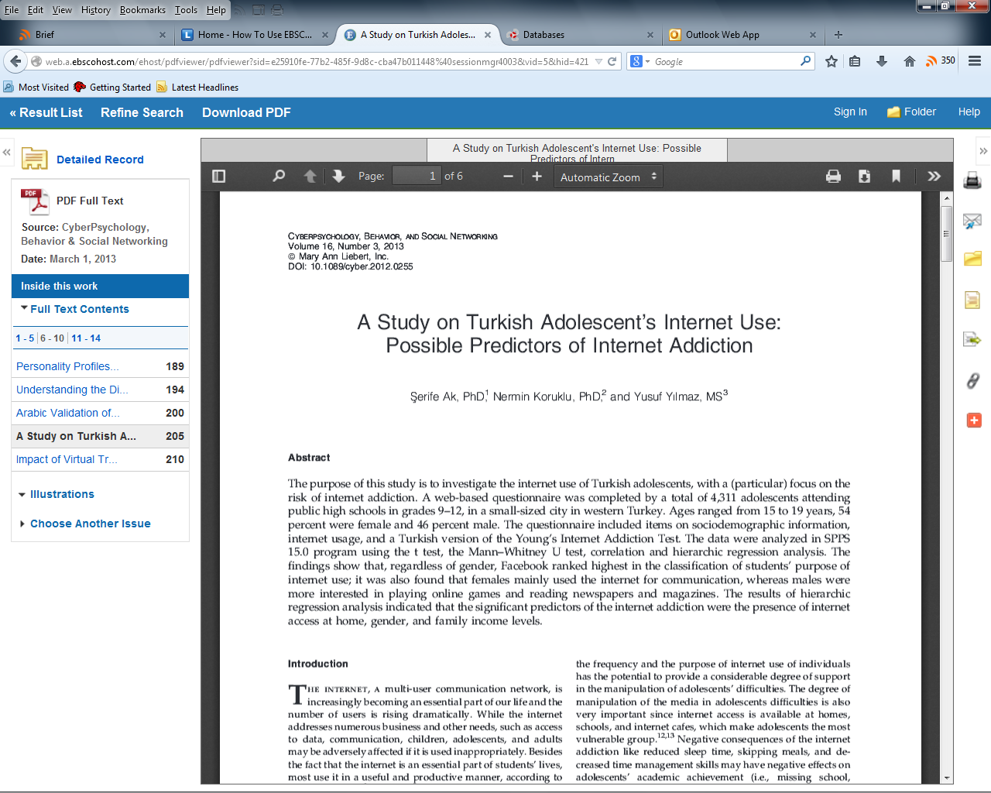
Full text of document
When the document is in PDF form, it can be open outside of the Ebscohost page.
Notes:
On the search results page, you will see the full-text link right below each search result.
On the article information page, you will see the full-text link at the top left corner of the page.
PDF full-text or HTML full-text
When the article is available in the database, you will see a little icon for it.
PDF full-text has the exact same appearance as the print version.
HTML full-text has the same words and images, but the layout is like a web-page.
"Check for full-text availability in all library collections"
Most databases index, or list, more content than they actually have in full-text. While this can be frustrating, it's useful because at least it lets you know those documents exist out there somewhere. Often, they exist right in our library, just in a different database. That's where Article Linker comes in. Article Linker is a behind-the-scenes tool that will link you to the full-text wherever it occurs.

Slide 25
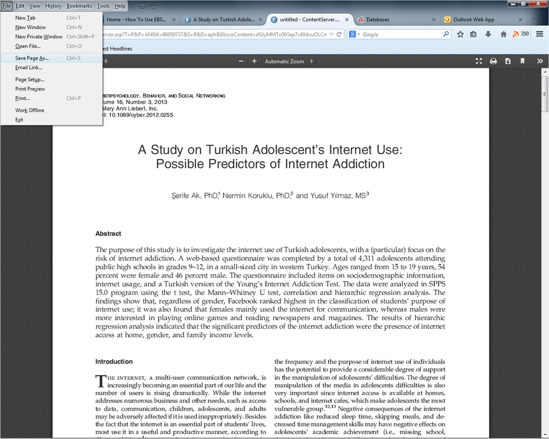
Full text of document
You may save the document by clicking on
File →
Save Page As
Notes:
On the search results page, you will see the full-text link right below each search result.
On the article information page, you will see the full-text link at the top left corner of the page.
PDF full-text or HTML full-text
When the article is available in the database, you will see a little icon for it.
PDF full-text has the exact same appearance as the print version.
HTML full-text has the same words and images, but the layout is like a web-page.
"Check for full-text availability in all library collections"
Most databases index, or list, more content than they actually have in full-text. While this can be frustrating, it's useful because at least it lets you know those documents exist out there somewhere. Often, they exist right in our library, just in a different database. That's where Article Linker comes in. Article Linker is a behind-the-scenes tool that will link you to the full-text wherever it occurs.

Slide 26
EBSCOHost
Login Information

Slide 27
Before you begin….
Go to library's home page at www.nalis.gov.tt
Click the link : Access our databases.
When the new pages loads, look for and click the link: EBSCOHOST FULL-TEXT DATABASES.
When the login page loads, enter your Library Card Number and PIN. Click login.
Once your user ID and PIN are correct, you will be presented with a page that lists all the EBSCO databases.

Slide 28
Login Step 1
In the address bar of any web browser, type www.nalis.gov.tt and press the Enter key.
This will open up the NALIS home page.

Slide 29
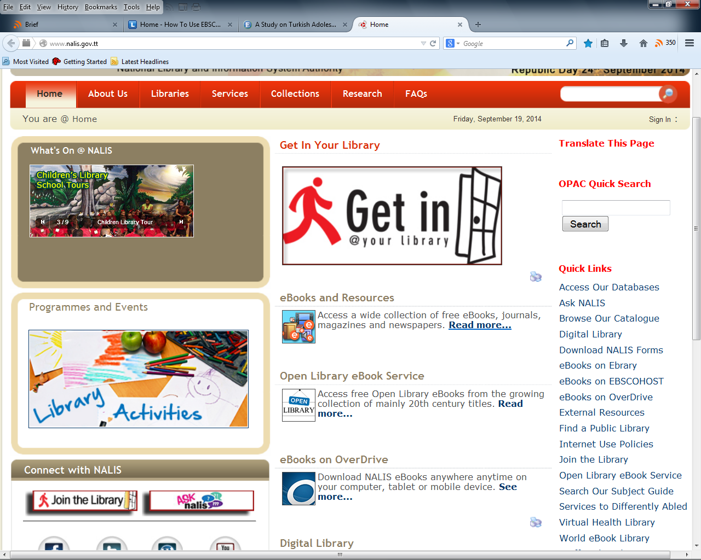
Login Step 2
On the NALIS homepage, click the link : Access our databases.

Slide 30
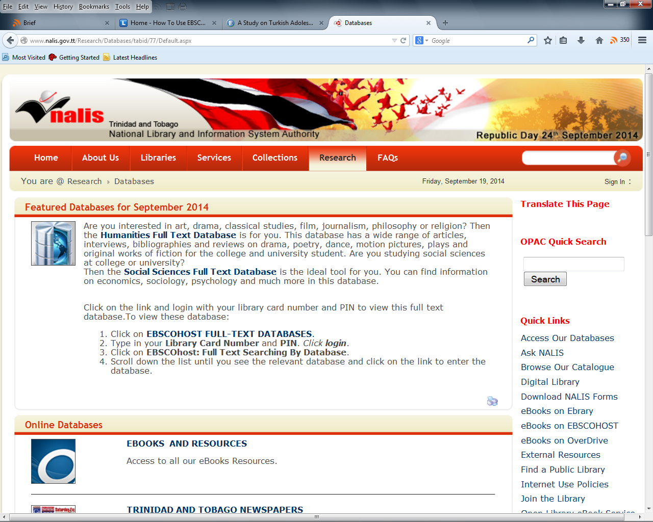
Login Step 3
When the new page loads, look for and click the link:
EBSCOHOST FULL-TEXT DATABASES.

Slide 31
Login Step 4
Enter PIN
When the login page loads, enter your Library Card Number and PIN.
Click login.

Slide 32
Login Step 5
Once your user ID and PIN are correct, you will be presented with a page that lists all the EBSCO databases.

Slide 33
Login Step 6
Searching a single database.
You may search a single EBSCO database or subject area by clicking on its name, such as
Point of View,
Business Source,
EBSCOhost: Full Text Searching for Secondary Students
Caribbean Search: Full Text Searching etc.

Slide 34
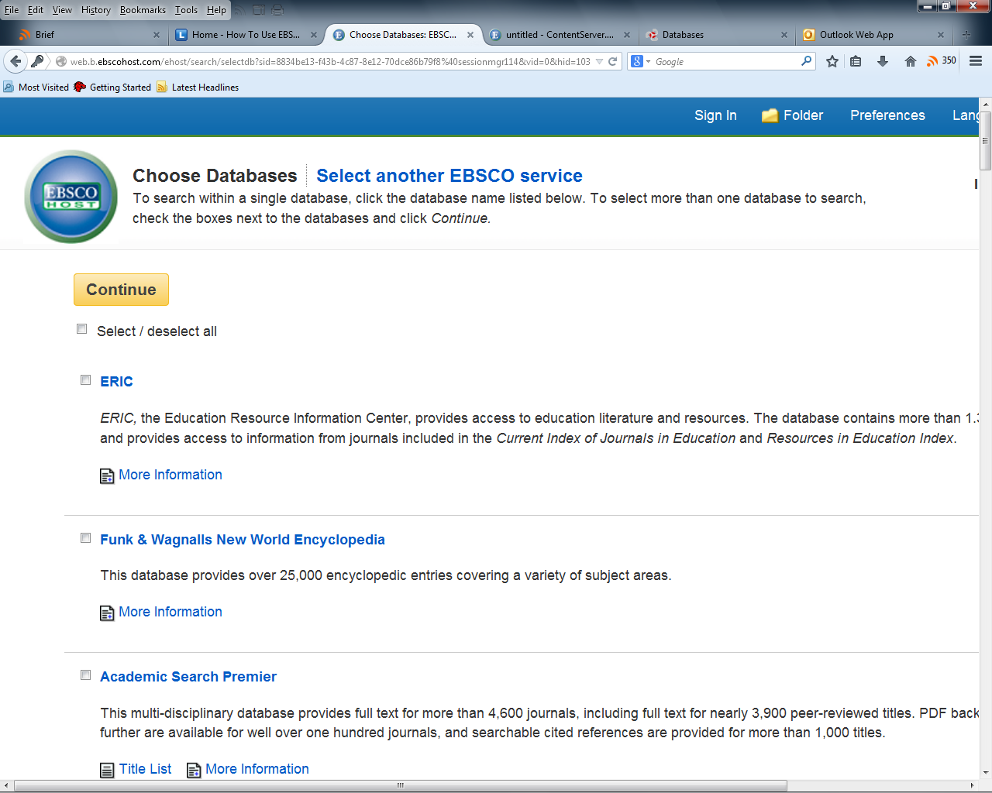
Login Step 7
Searching all databases at once.
Check off as many databases as you want and click the Continue button.

Slide 35
Login Step 8
After choosing database or databases, you will be presented with the Basic Search page.
Enter your search here.

Slide 36
The End

